Slide 1

Chapter 1
Communication

Slide 2
Contents
1 Definition of Communication
2 Process of Communication
3 Principles of Communication

Slide 3
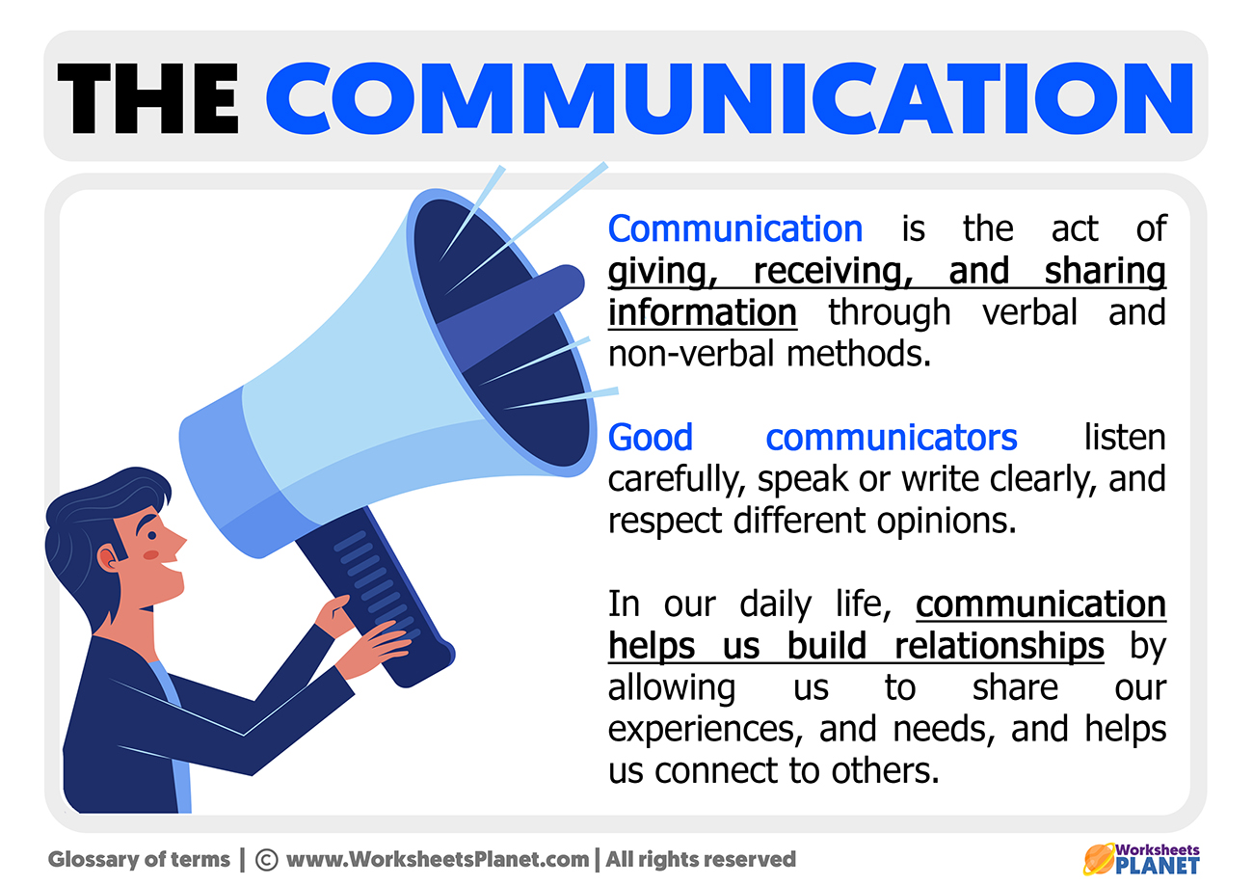
1.1 Communication

Slide 4
Communication
Communication (from Latin commūnicāre, meaning "to share, impart") is the act of conveying intended meanings from one entity or group to another through the use of mutually understood signs and meaning system.
Transfer of message from the sender/addressor to the receiver/addressee.
Exchange of information between the addresser and addressee.
“Communication is an exchange of facts, ideas, opinions or emotions by two or more persons.”- Newman and Summer
“Communication is the exchange of information and the transmission of meaning. It is the very essence of a social system of an organization.”- Katz and Kahn
”Communication is transfer of information from one person to another, whether or not it elicits confidence. But the information transferred must be understandable to the receiver.” – G.G. Brown.
“Communication is the intercourse by words, letters or messages.”- Fred G. Meyer.
“Communication is the sum of all the things one person does; when he wants to create understanding in the mind of another. It involves a systematic and continuous process of telling, listening and understanding.” -Allen Louis

Slide 5
Two Schools in the Study of Communication
Process school:
Process school sees communication as the transmission of message.
It focuses on how senders and receivers encode and decode messages, and how transmitters use channels and media.
It emphasizes efficiency and accuracy in communication.
Communication is seen as a process of affecting behavior or state of mind of another person.
Communication failure happens when the effect is different or smaller than intended.

Slide 6
The Semiotic School:
Semiotic school: communication = production/exchange of meaning
Concerned with how text/message interacts with people to produce meaning
Focus on role of text in culture
Misunderstanding due to cultural differences, not communication failure
Communication = study of culture and text
Message = signs interacting with receivers to give meaning
Sender less important, emphasis on text and how it's read
Reader brings cultural experience to interpret text
Multiple meanings due to social/cultural differences

Slide 7
…
Communication can be verbal or non-verbal.
Communication can be internal or external.
Communication can take place in two people as well as in-group.
Communication can involve human, machine or animals.
It is a dynamic process
It is the lifeblood of business.

Slide 8
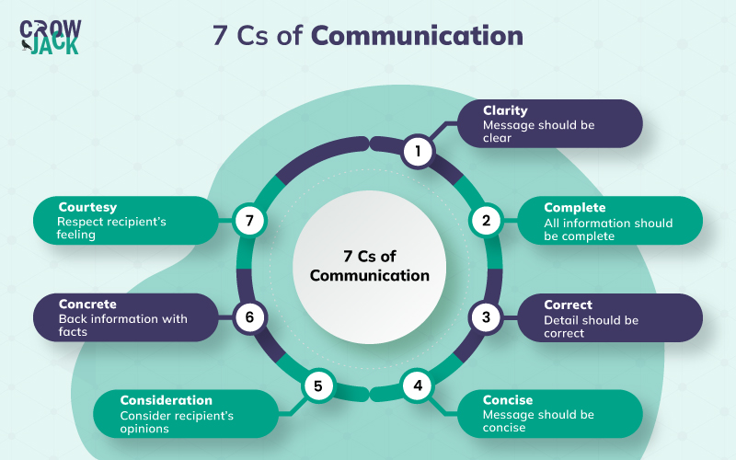
1.5 Principles of Communication (7 Cs)
Clarity
Completeness
Conciseness
Concreteness
Consideration
Correctness
Courtesy

Slide 9
1. Clarity
Using accurate manner so that the receiver understand what is originally conveyed
Difficult task (words have multiple meanings)
Clarity is maintained by:
- using precise, familiar and easy words
- constructing effective sentences and paragraphs
- making easily readable and easy to grasp when spoken out
- using visual aids like illustrations and graphics

Slide 10
2. Completeness
A complete message will have all the facts/details needed by the audience
Ask 5Ws+1H or journalistic questions (who, what, where, when, why and how)
Recognize receiver’s needs, background, attitude and emotions
For eg, If you want to write a brochure on your beautiful mountain village to promote it as a touristic spot, you will need to provide a complete profile of the village, including its location, map, landmarks, demographics, culture, travel logistics, estimated costs etc.

Slide 11
3. Conciseness
Using fewest words
A concise message is without wordiness, awkward constructions and redundancies.
Conciseness:
- helps to emphasize
- make important ideas stand out
- saves the time and resources

Slide 12
4. Concreteness
Message should be specific, definite and vivid with relevant details
Concreteness is maintained by:
- using facts and figures
- using image building words or phrases
- using action verbs

Slide 13
5. Consideration
It is keeping the audience in mind.
It is putting yourself in your audience’s shoes, and empathizing with them, eager to address their needs, always positively and with integrity.

Slide 14
6. Correctness
It is concerned with using:
- correct grammar
- punctuation
- spelling and other mechanics
- proper body language
- proper tone
- political correctness (not using harsh language in terms of race, gender, religion etc)
- correct facts and figures
- sources
- appropriate language according to the situation (formal and informal)

Slide 15
7. Courtesy
It involves showing concern for the recipient, being polite, sincere, and thankful to others
It helps to win new friends
It is a way to avoid annoying or hurtful expressions
It is the ability to say ‘thank you’ or ‘sorry’ to the audience

Slide 16
1.3 Process of Communication
Communication process generally includes:
i. Sender/encoder
ii. Message
iii. Medium/channel
iv. Recipient/decoder
v. Feedback
vi. Context

Slide 17
i. Sender/encoder
The person who sends the message (symbols such as speech, written words, gestures etc.) with the intended meaning.
A sender is a source of the message
It could be an individual/institution
An ideal sender is one who has the abilities of a good communicator

Slide 18
ii. Message
The key idea with a meaning conveyed by the sender to the receiver.
The effectiveness of message depends on:
- How accurate and clear it is
- How well it suits the needs of the sender, medium and recipient

Slide 19
iii. Medium/channel
The means by which a message is conveyed to the receiver
There are different channels like- letter, telephone, fax, email etc.
It is determined by the nature of audience, message and the receiver.
Eg: folk media like street drama, or FM radio could be more effective today to communicate a health message to the rural audience in Nepal.

Slide 20
iv. Recipient/decoder
Individual(s) for whom the message is intended for or targeted at.
An ideal recipient is one who is receptive, and has the abilities to understand the intended message.

Slide 21
v. Feedback
It is the response by the recipient.
It is the return message sent by the receiver to the sender.
It can be either verbal or non-verbal.
It helps to make communication a circular rather than a linear process.
It helps to relate to the intended meaning of the message, or to assess its effectiveness.
It helps to improve communication next time.

Slide 22
vi. Context
A message is always communicated within a context.
It could be physical, social, cultural, psychological or temporal.
It could be more than one at the same time.
Appropriate contexts help in the efficacy of the message.
Inappropriate context serve as barrier to communication.
Eg: a Pepsi-Cola advertisement on radio in Terai is more effective during summer than in the winter.

Slide 23
THANK YOU

